Slide 1

Seminar 1: Personal Banking
Summary:
Budgeting
Benefits
Saving Strategy
Banking
Credit

Slide 2
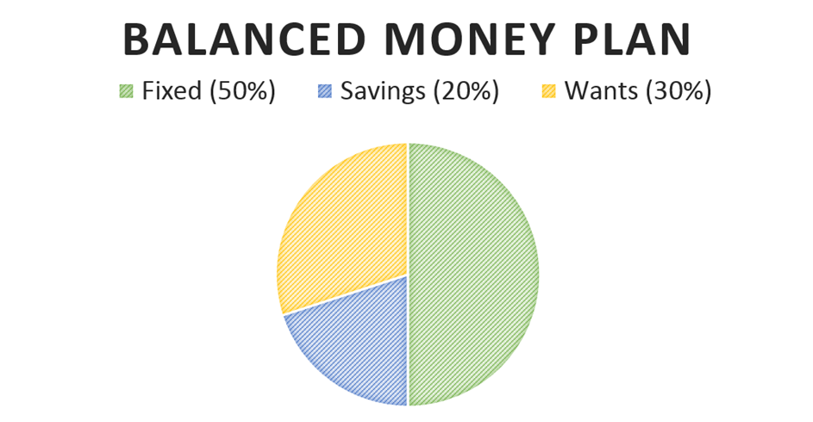

Slide 3
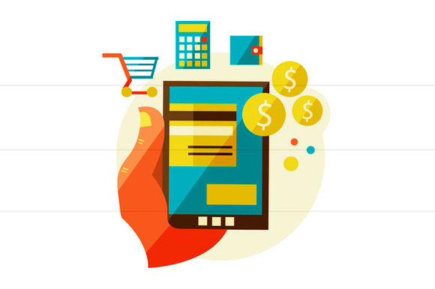
Fixed Spending (50% or less)
Rent
Car Payments
Phone Bill
Basic foods
Insurance

Slide 4

Variations
Age
Children
Self-employment
Goal: 30% on housing/renting

Slide 5
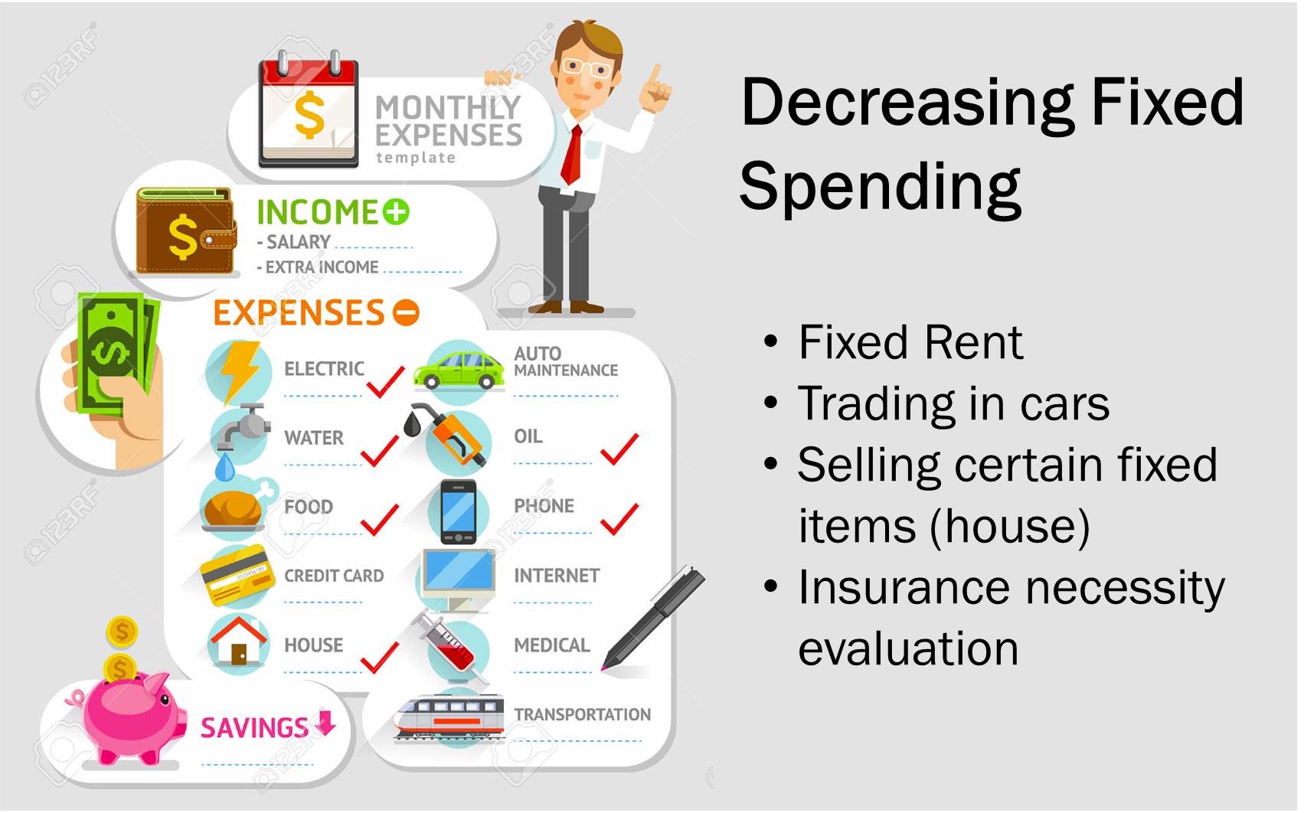
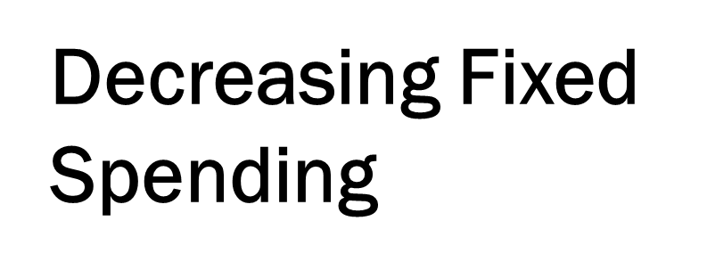
Fixed Rent
Trading in cars
Selling certain fixed items (house)
Insurance necessity evaluation

Slide 6

Savings (20% or more)
Benefits
Protection from:
Job Loss
Turn in the Market
Boom and Bust Pattern
Unexpected family increase
Injury
College
Opportunity:
Stable credit score
Lower interest rates
Increased Loan Options

Slide 7

Expendable Spending (30% or less)
What qualifies as expendable?
Non monthly payments
Going to the movies
Eating out
What are some examples that you can think of?

Slide 8

--------------------------------Banking-----------------------------
Types of Accounts
Checking
Savings
Alternate Banking

Slide 9
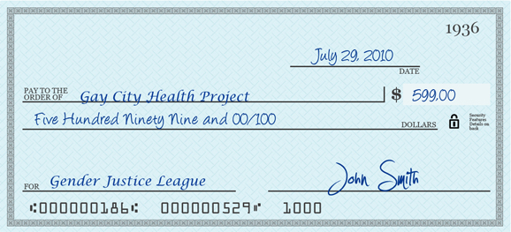
Writing a check
Name or person you’re paying
Date
Amount being paid
Amount in Words (cursive)
Memo: optional description of the intention behind payment
Ex: phone bill etc.
Routing Number:
(# of the bank processing the check)
Account Number
(unique to you & followed by |:
Check Number
(different)
Signature

Slide 10
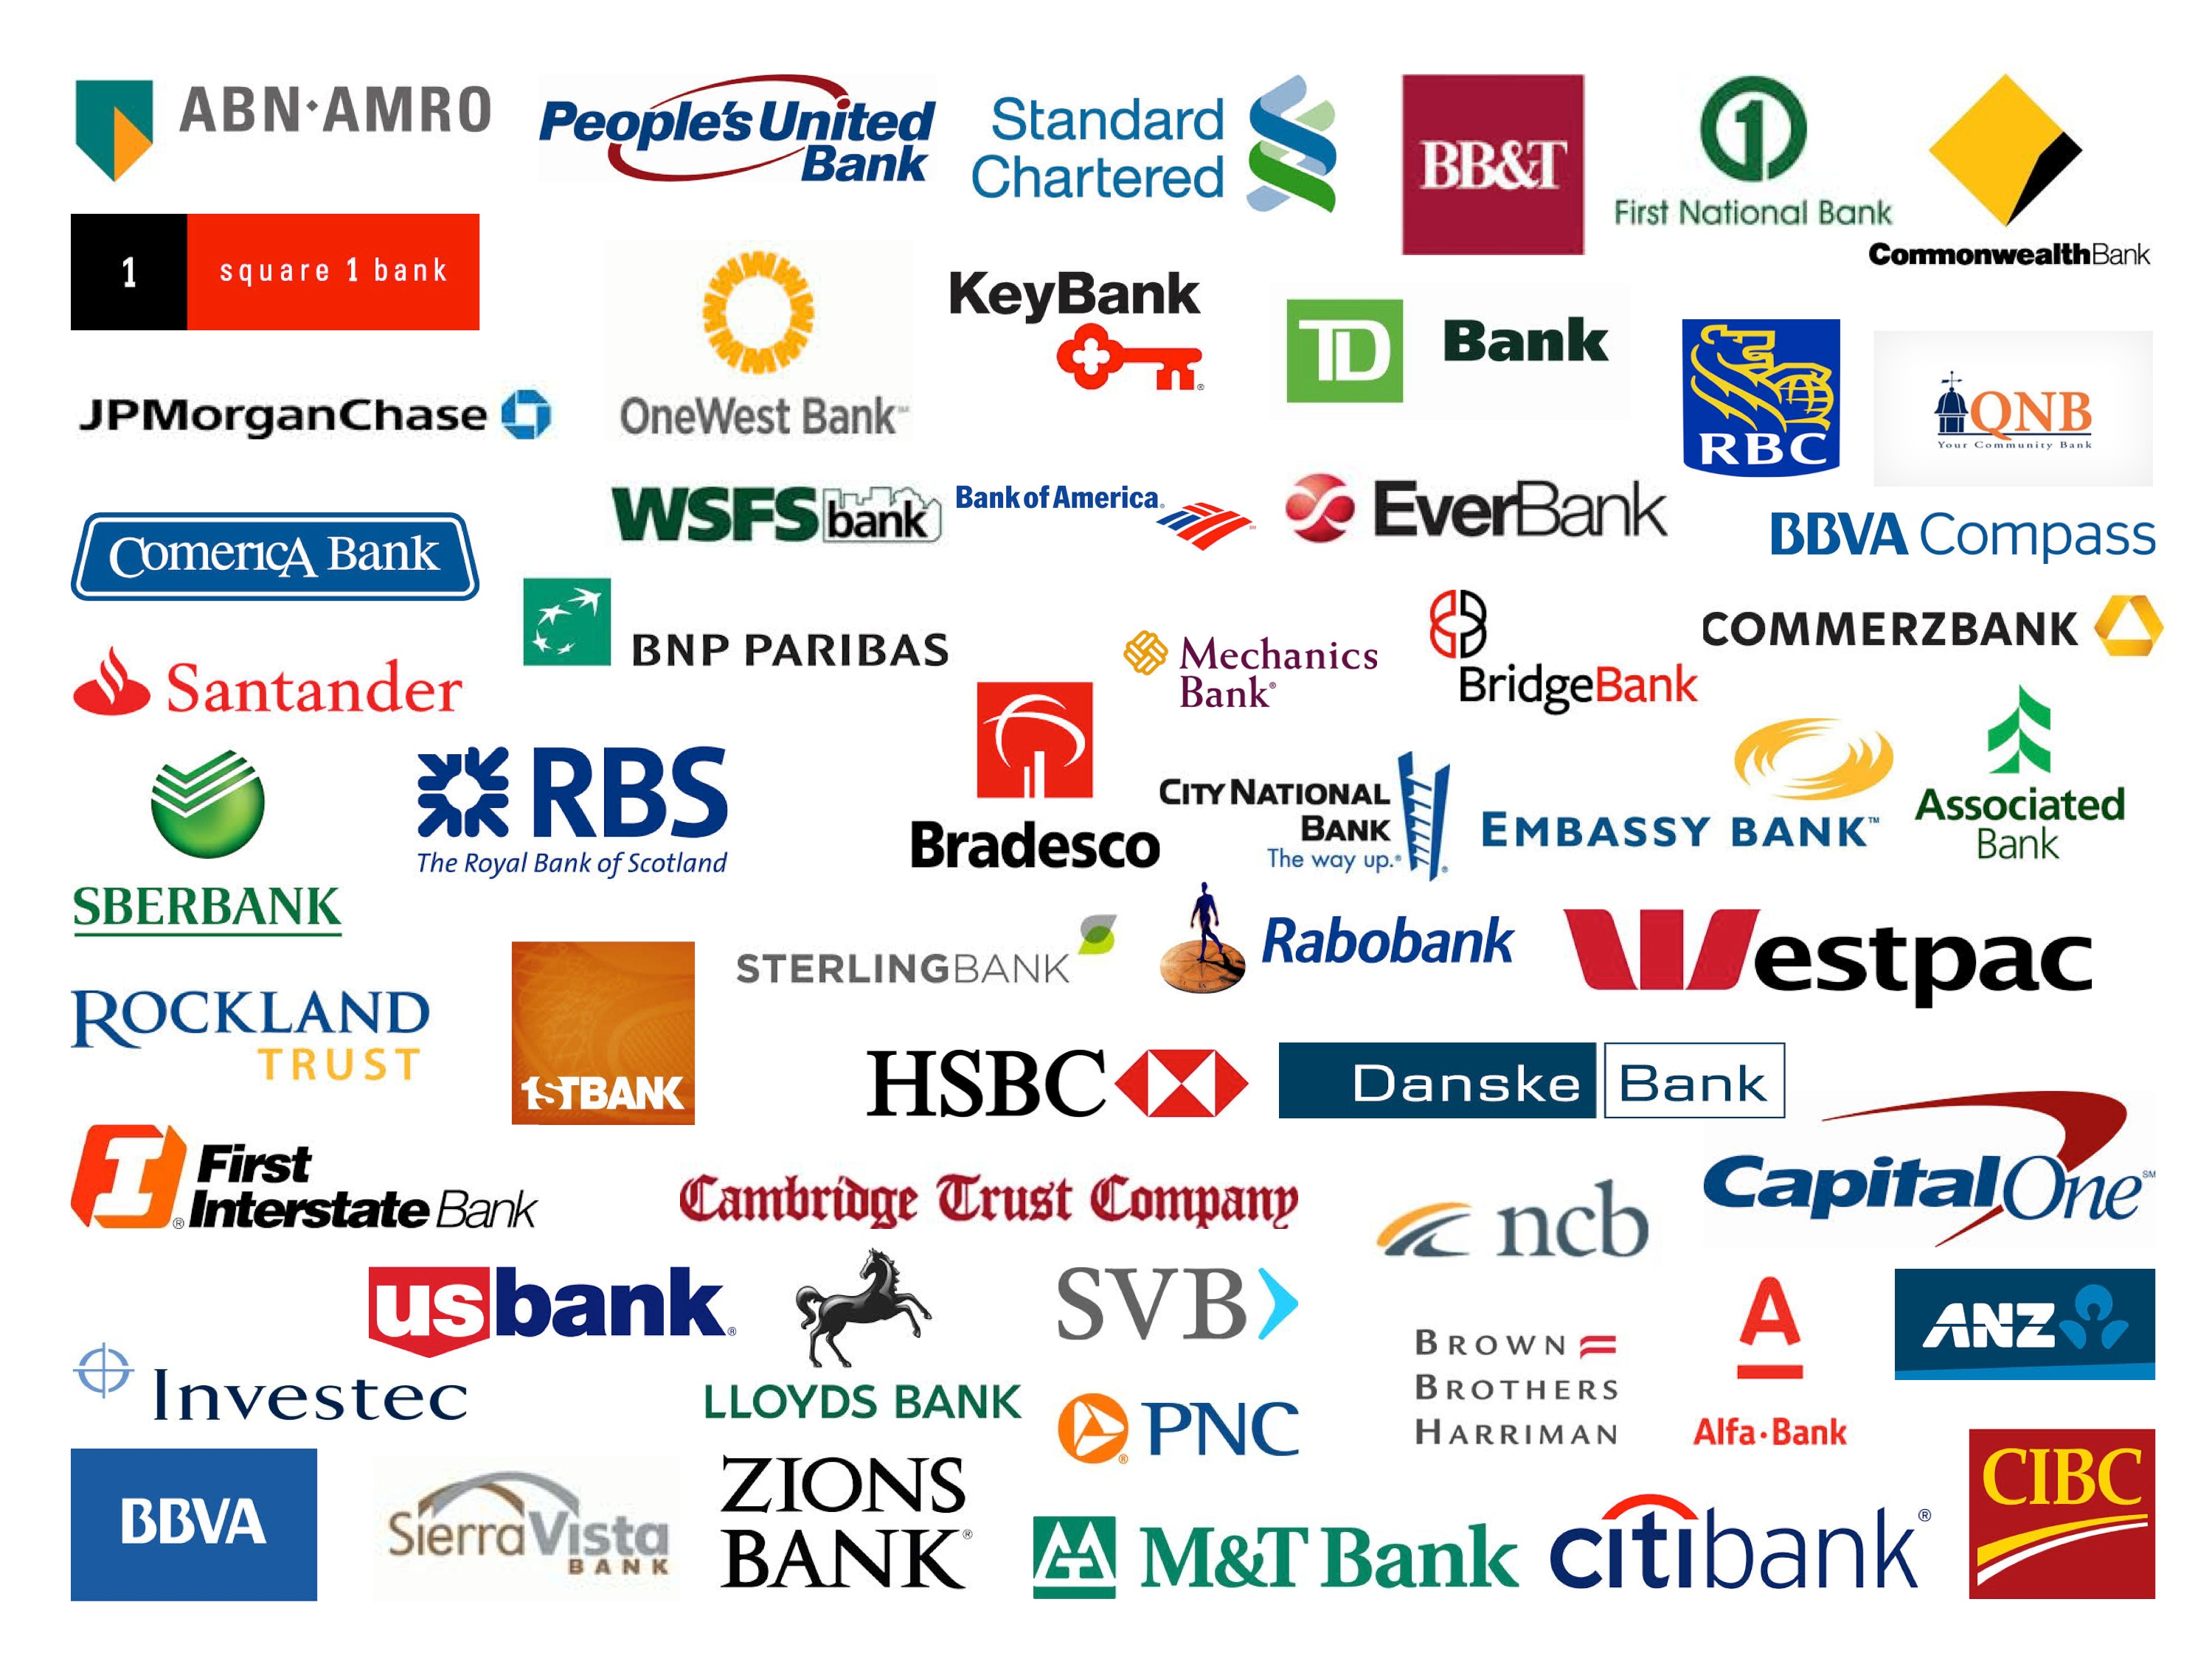
Banking Options

Slide 11
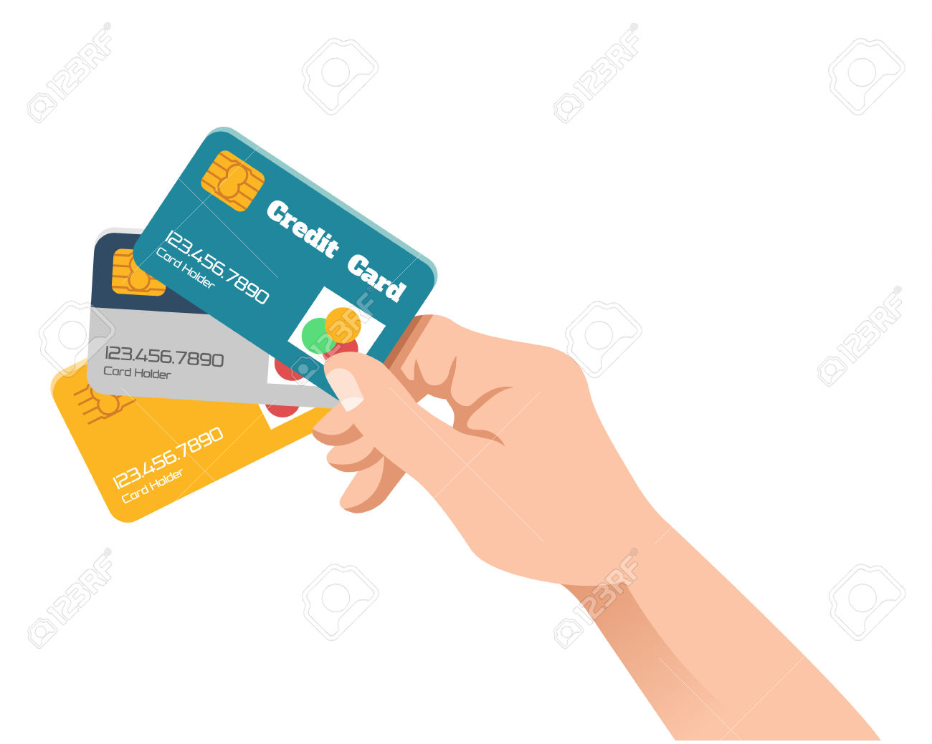
Credit
Credit Report
Credit Score
Receiving a score (FICO)

Slide 12
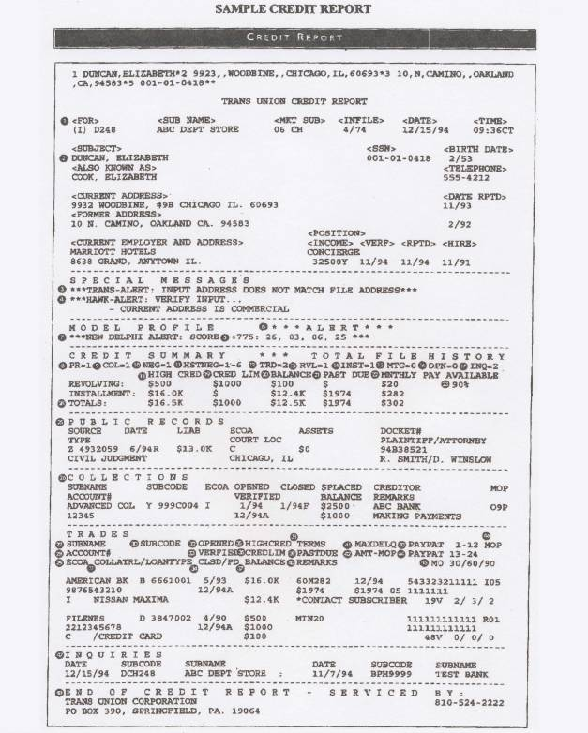
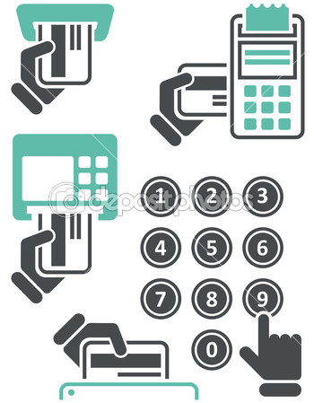
Credit Report
example

Slide 13
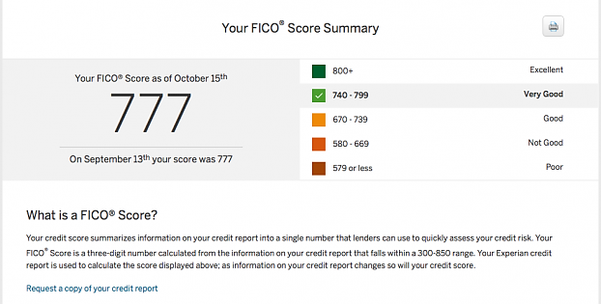
Example Credit Score

Slide 14
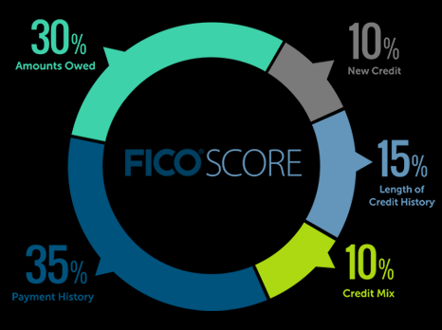
Fico Score Composition

Slide 15
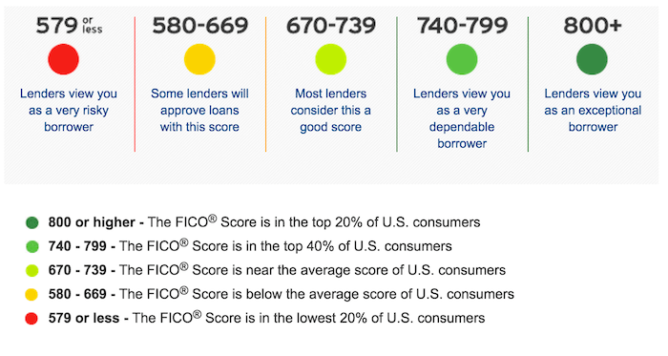
Score Meaning

